Slide 1


Math415/ ISYE495 Design of Experiments
term project
Hamza Hindi 100045100
Begad El houty 100045069
Nouran Ahmed 100044978
Maha Al Dhaheri 100042582

Slide 2

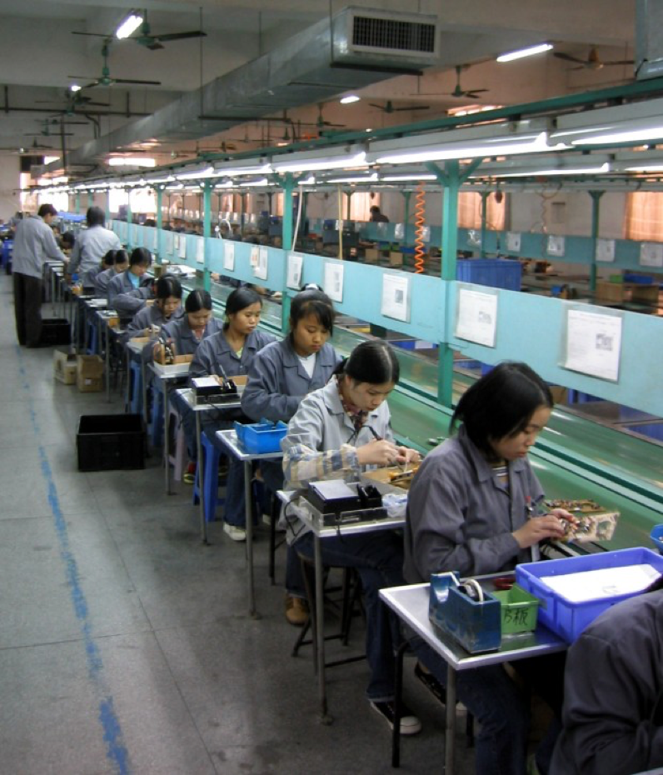
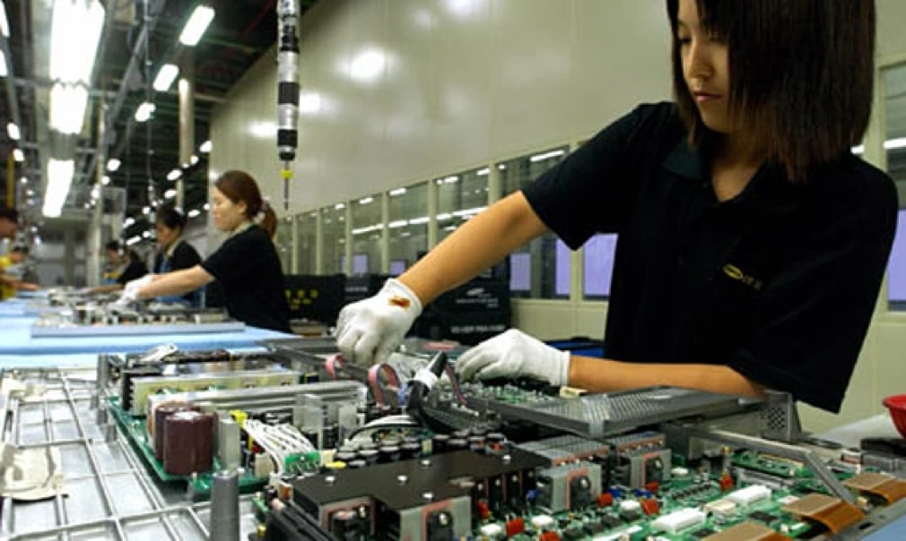
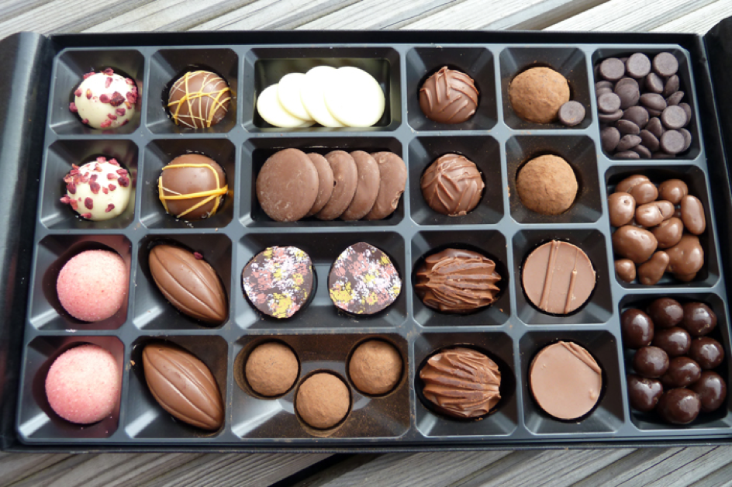
What skills do the workers require?

Slide 3

Dexterity
The ability to perform a difficult action quickly and skillfully with hands.
Important features of dexterity testing:
The precision of the movement
Defining the beginning and end points of the movement
The stability of the environment
Notes:
https://dictionary.cambridge.org/dictionary/english/dexterity
These are the three features that play a role in dexterity testing:
The precision of the movement
Defining the beginning and end points of the movement
The stability of the environment
https://www.prohealthcareproducts.com/blog/minnesota-dexterity-test-guide-and-instructions/

Slide 4

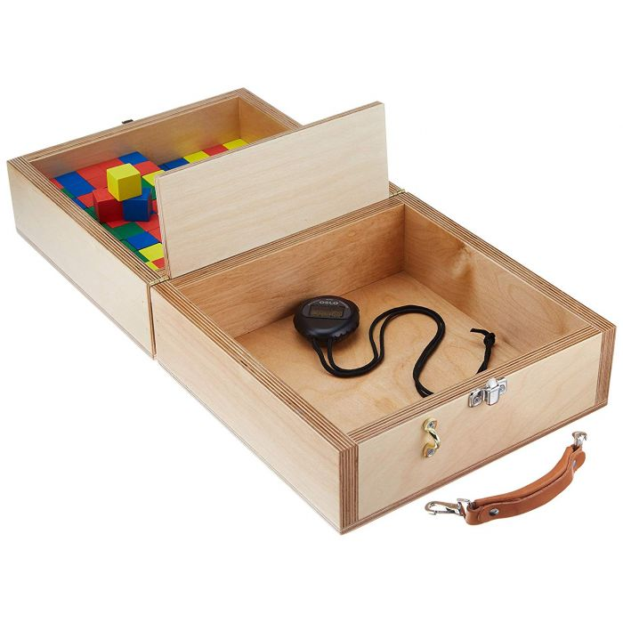
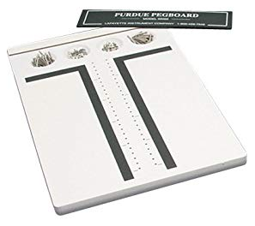
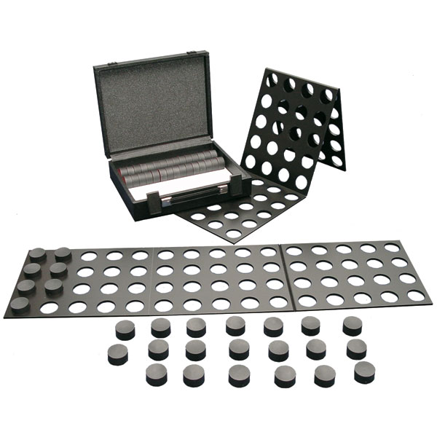
Common dexterity tests
Notes:
•Complete Minnesota Dexterity Test (CMDT)
•Box and Block Test
•Purdue Pegboard Test

Slide 5

COMPLETE MINNESOTA DEXTERITY TEST (CMDT)
Tool for an effective evaluation of rapid eye-hand-finger movement, arm-hand movement, & gross motor skills.
Involves placing/ moving 60 discs in a prescribed manner.
Five tests can be performed:
Turning
Placing
Displacing
one hand turning and placing
two hand turning and placing.
Notes:
•Complete Minnesota Dexterity Test (CMDT)
The Minnesota Manual Dexterity test is simple but effective for evaluating rapid eye-hand-finger movement as well as arm-hand movement and gross motor skills. When measuring gross motor skills: precision of movement is not as important as the successful execution of the skill.
The Minnesota Dexterity test is able to be used in diverse settings from rehabilitation to workplace testing making it one of the most popular dexterity tests available on the market. The Minnesota Dexterity test can be used to evaluate a single person or a group if necessary.
https://www.prohealthcareproducts.com/blog/minnesota-dexterity-test-guide-and-instructions/

Slide 6
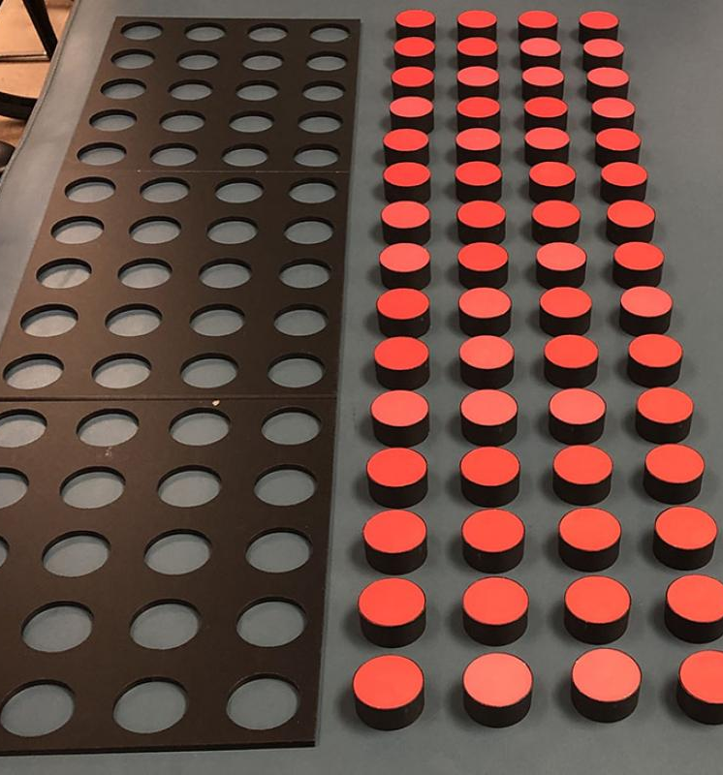
How to use the CMDT: Initial preparation
Place the board about 10 inches from the edge of the table.
Insert each disk in the holes
Lift the board upwards allowing the disks to come through the holes but remain in straight rows and columns
Place the board in front of the disks, about 1 inch from the edge.
A stopwatch is needed to measure time.
Notes:
How to put the Minnesota Manual Dexterity Test into Starting Position: Place the testing board on the table about 10 inches from the edge. There are holes in the board for disks. Insert each disk and then lift the board upwards which will allow the disks come through the holes, but remain in straight rows and columns on the table. Now the practitioner will place the testing board in front of the disks on the table. Keep the board about 1 inch from the edge of the table closest to the subject. This is will be starting position. A stop watch is needed in order to time the test.
https://www.prohealthcareproducts.com/blog/minnesota-dexterity-test-guide-and-instructions/

Slide 7
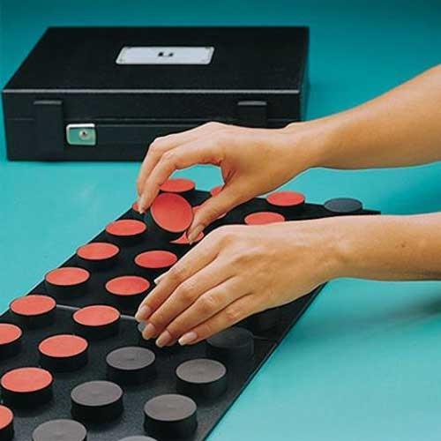
How to use the CMDT: Turning test
Pick up disk from upper right-hand corner with one hand
Turn the disk over while passing to the other hand, return to original hole with bottom side facing up
Continue in that row moving to the left, repeat for other rows.
Notes:
For Turning test: This test is used to determine the speed in which a subject can pick up disks with one hand and turn them with the other hand before replacing the disks into holes of the testing board.
Pick up disk form upper right-hand corner with left hand
Turn disk over while passing it to the right hand and return it into the original hole with bottom side facing up. Continue in that row moving to the left
Repeat this action for the second row moving towards the right
Move right to left along board for third row (same as first row) and finally, left to right for fourth row (same as second row)
https://www.prohealthcareproducts.com/blog/minnesota-dexterity-test-guide-and-instructions/

Slide 8
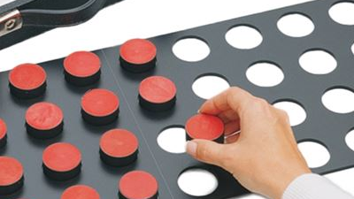
How to use the CMDT: Placing test
Start on the right side of board
Pick up bottom disk and insert into top hole of board
Follow with next disk above empty hole on the top board, place in the hole below the disk in the bottom
Fill in the first column downward, repeat.
Notes:
For Placing test: This test is used to evaluate the speed a subject can put the disks from the top board into bottom board using their dominant hand.
Start on right side of test board
Pick up bottom disk and insert it into top hole of board
Follow with next disk above empty hole on the top board, placing it in the hole below the disk in the bottom board
Continue pattern in the right column
https://www.prohealthcareproducts.com/blog/minnesota-dexterity-test-guide-and-instructions/

Slide 9
Applications
Physical and Occupational therapy: provides a baseline and track progress throughout rehabilitation.
Vocational applications: measures prospective student’s ability to perform tasks similar to those they will find in their chosen field of study.
Pre-employment screening: to identify candidates with the necessary hand-eye coordination skills for jobs requiring high level of fine-motor skills.
Neurological, physiological and medical researchers: from identifying brain damage, diagnosing dyslexia, to furthering research studies.
Notes:
Physical Therapy: When a patient suffers an injury to the hand or wrist or suffers from a condition like carpal tunnel, a dexterity test can be useful to provide a baseline and track progress throughout their physical therapy rehabilitation.
Occupational Therapy: When a person suffers from tendon injury in the hand it can affect their ability to flex or extend the hand and fingers. In addition to pain as a result of the injury it can create complications for the patient making it difficult to complete life tasks such as bathing, dressing, grooming, eating, using the bathroom in addition to making it difficult to perform work responsibilities.
Vocational Application: Vocational assessments can use dexterity testing as one way to measure a prospective student’s ability and aptitude when it comes to tasks similar to those they will find in the workplace of their chosen field of vocational study.
Pre-Employment Screening: Jobs that require a high level of fine-motor skill such as sewing or manufacturing jobs may use dexterity testing as part of their pre-employment screening process in order to identify candidates with the necessary hand-eye coordination skills.
Neurological, physiological, and medical researchers: From identifying brain damage, diagnosing dyslexia to furthering research studies in the neurological, physiological, and medical fields, dexterity tests play an important role not just in active rehabilitation but in furthering scientific discovery and innovation.

Slide 10

Factors : Initial Guess
Weights :
Wrist
Elbow
Method :
Turning
Placing
Hand :
Right
Left
Gender :
Male
Female
Height ( of table )
Level 1
Level 2
Age :
Old
Young
Environment (Music)
With
Without
Environment (Lighting)
High
Low

Slide 11
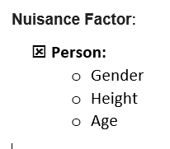
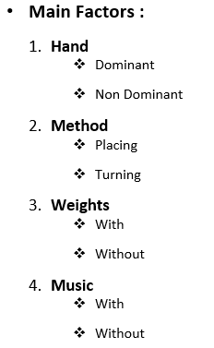
Factors : Final Decision
Confounded

Slide 12

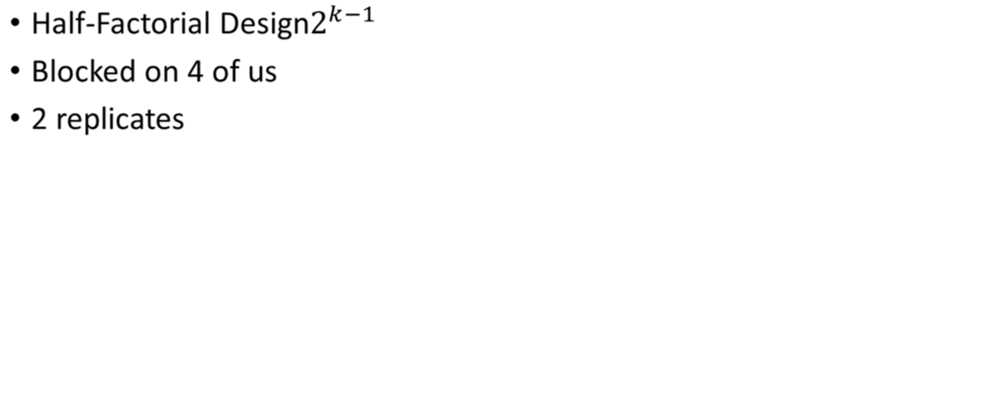
Methodology

Slide 13
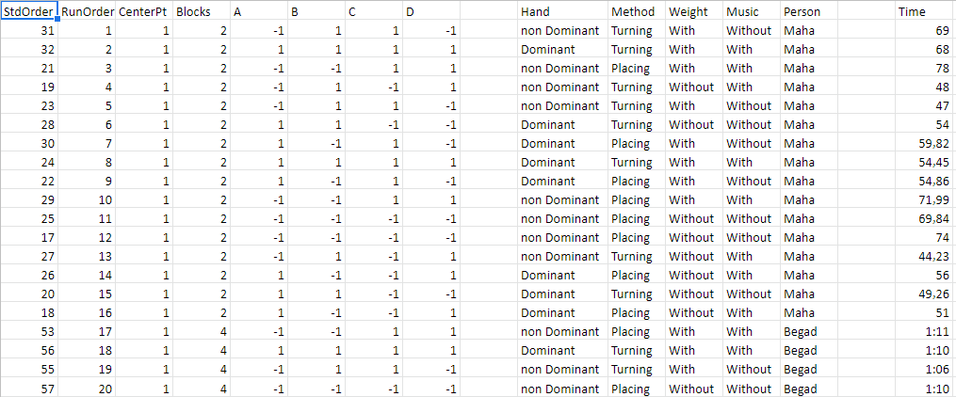
Our Design (Minitab)

Slide 14
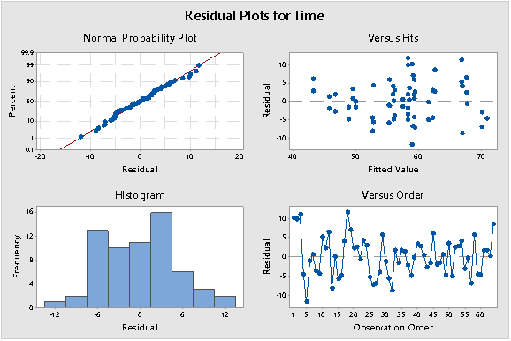
Assumptions
Normality of Residuals
Homogeneity of variance
Independence of Residuals

Slide 15
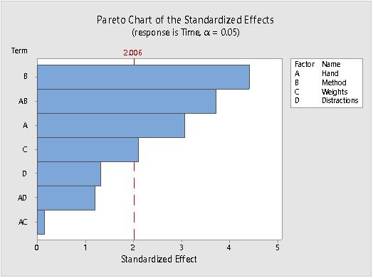
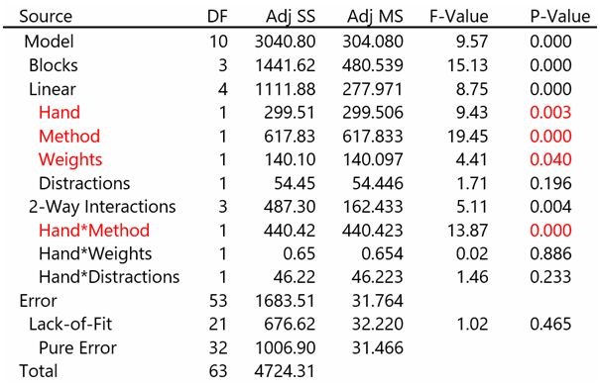
Half Factorial Design Results

Slide 16
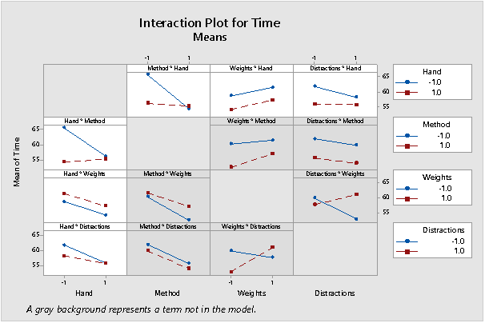
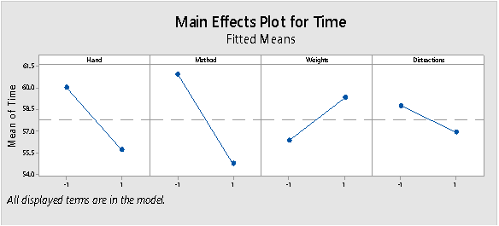
Let’s Explore More

Slide 17
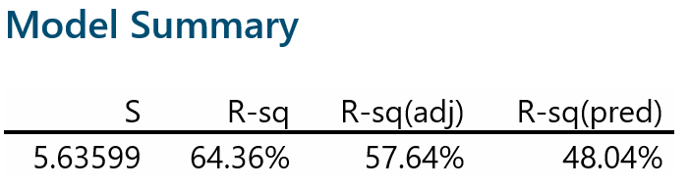

Slide 18
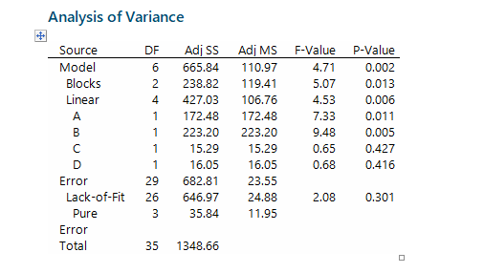
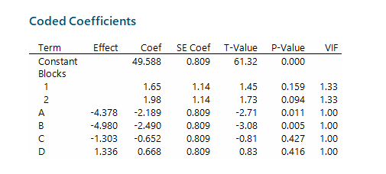
Screening experiment

Slide 19
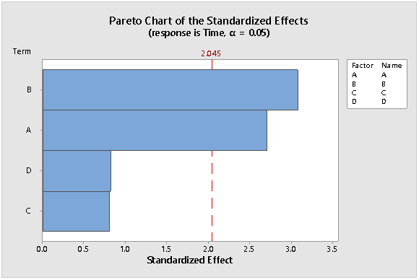
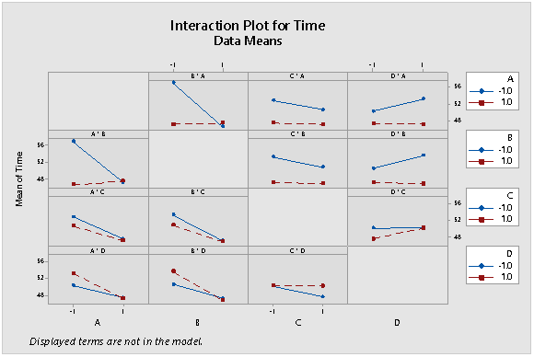

Slide 20
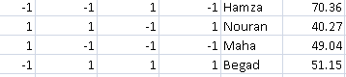
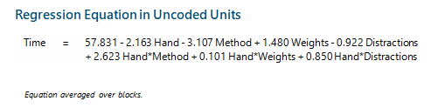
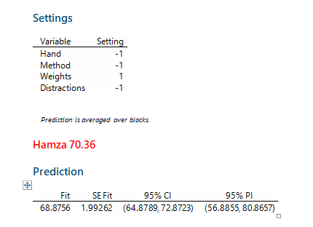
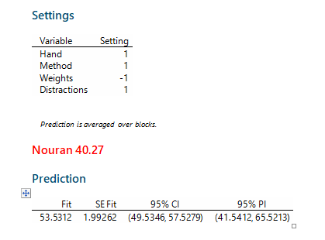
Additional 4 runs

Slide 21
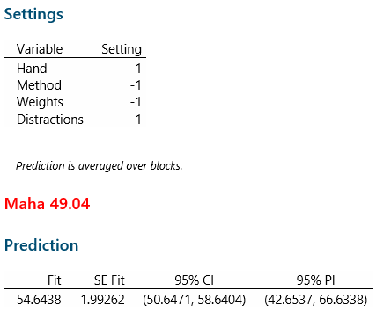
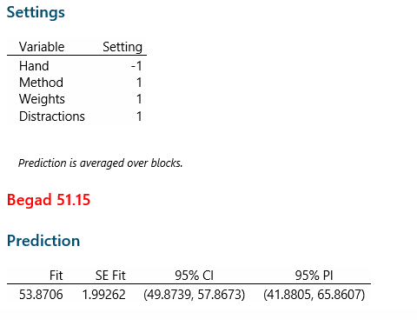
Additional runs continued…

Slide 22
Conclusion
Half-Factorial Design & Screening Experiment results agree that the:
Hand
Method
Hand x Method
had an effect on the time taken to complete the Minnesota Dexterity Test
More investigation needs to be done to solidify whether the effect of weights & weights x distraction have an effect and this can be done by folding over the Half-Factorial Design.

Slide 23

Thank you

